Slide 1
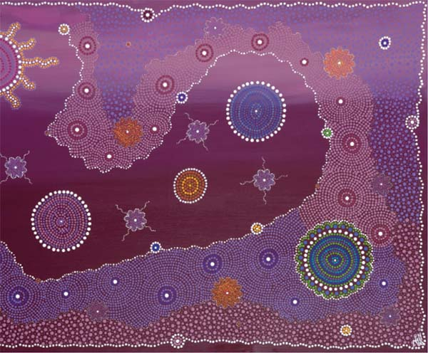

Week 3 Workshop:
Social and cultural determinants of health

Slide 2
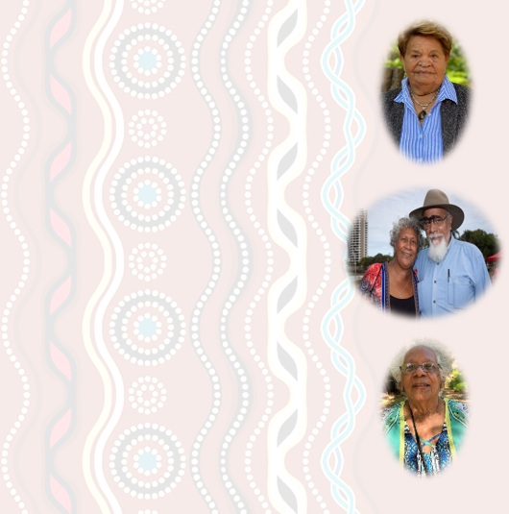
Gnibi Elders Principle that aligns with: Social & cultural determinants of health
Principle 5 “Our knowledge is relational. Our principles are the basis for SCU to establish and sustain an active informed and respectful relationship with Indigenous Elders who will give considered collective input. The continuance of this relationship through the Elders group is essential.”
https://www.scu.edu.au/about/first-peoples/gnibi-elders-council/

Slide 3

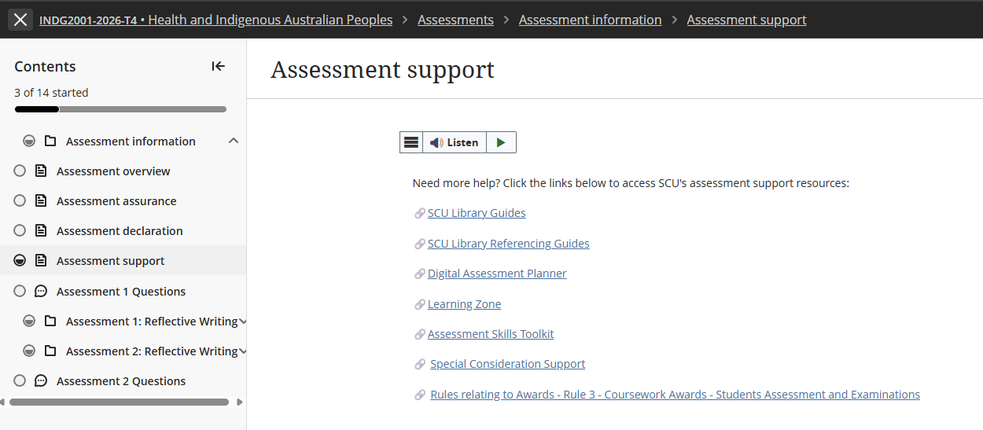
Special Considerations Support extension

Slide 4
Assessment 1 – Short Response
Title | Assessment 1
Type | Short response
Length | 1,000 words
Weighting | 40%
Academic Integrity | Level 2. Purpose-Specific GenAI Use GenAI may NOT be used EXCEPT Grammarly Premium AI.
Submission | Word document submitted to Blackboard
Unit Learning Outcomes | This assessment task maps to the following ULOs: ULO1: Discuss key concepts of health and wellbeing as determined by Aboriginal People. ULO2: Identify key stages of the colonisation process and its relationship to the contemporary health status of Australian Indigenous People.

Slide 5
Overview to Writing a Short Response
Always use unit approaches (concepts, theories, models, processes or guidelines) in your short responses. Often, this means defining and applying unit concepts or theories.
Before you start working on the assessment, find definitions in the unit materials. This step will help you gain a more detailed grasp of unit ideas and theories so that you can show this understanding to the marker.
Don't try to COVER EVERYTHING you know about a topic. While it can be tempting, this is not your task in a short response, and you don't have enough words. Offer your informed answer to the question within a limited word count.
As you brainstorm, plan, and draft keep trying to narrow, narrow, narrow your focus.
You can use headings in a short response, it is part of the word count.

Slide 6
10 Key Steps for Strong Short Response Writing
Start with a clear main point: Emphasise that short responses must begin with the answer, not background. Example sentence starters such as: “This concept refers to…” or “In the scenario, this is evident when…”.
2. Explain the key concept briefly: Define or clarify the concept in their own words before applying it. This prevents vague or incorrect use of terms
3. Link the concept to UNDRIP Article 3
Show clearly how the concept relates to the rights described in Article 3 and to Australian Indigenous Peoples understandings of health and wellbeing. Interpret the connection—do not retell general background information.
4. Use scholarly or unit evidence: Short responses still require academic grounding. Evidence can be a unit concept, framework, or scholarly idea. Keep it brief.
5. Write concisely and coherently: Use short, direct sentences - improves clarity and reduces grammatical errors - avoid long introductions, unnecessary detail, or narrative writing.

Slide 7
10 Key Steps for Strong Short Response Writing continued …
6. Maintain respectful terminology: Remember: Correct and consistent use of your chosen term
7. Conclude by linking back to the question: A final sentence should reinforce the main point to close the paragraph logically and signals relevance to the marker.
8. Avoid common pitfalls: Highlight typical issues: over‑description, missing the main point, unclear links to Article 3, lack of evidence, incorrect terminology, and overly long sentences.
9. Use postgraduate verbs: Encourage verbs that show analysis and interpretation: analyse, interpret, examine, integrate, contextualise. Discourage vague verbs like talk about or discuss.
10. Follow a simple structure (PEEL): Point → Explain → Evidence/Scenario → Link.

Slide 8
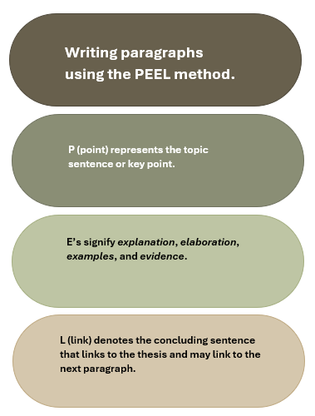
PEEL Writing Structure

Slide 9
Assessment 1 Overview
Purpose of the Assessment
Builds understanding of Australian Indigenous perspectives of health and wellbeing.
Introduces self‑determination as a core principle in UNDRIP Article 3.
Highlights differences between Australian Indigenous wholistic health and Western biomedical models.
Examines how colonisation has limited the ability to exercise self‑determination.
Develops foundational knowledge for culturally safe practice in health, social services, and community work.
Strengthens critical thinking and culturally grounded analysis for professional contexts.
Task Description
Read Article 3 of the United Nations Declaration on the Rights of Indigenous Peoples (UNDRIP):
"Indigenous peoples have the right to self-determination. By virtue of that right, they freely determine their political status and freely pursue their economic, social and cultural development."
Write a 1,000-word short response explaining how this article relates to Australian Indigenous Peoples understandings of health and wellbeing.

Slide 10
Assessment 1 - Instructions
Step 1: Read UNDRIP Article 3
Consider what the term self-determination means and why it is important for Australian Indigenous Peoples.
Step 2: Review Unit Content
Use learning materials from:
  Module 1: Australian Indigenous concepts of health and wellbeing.
  Module 2: Colonisation and its impacts on Australian Indigenous health and wellbeing.
Step 3: Research
Locate additional scholarly literature that supports your discussion.
  Definition of Scholarly and Peer-Reviewed sources
  Peer-reviewed sources are academic publications that have been evaluated by experts before publication to ensure quality, accuracy, and credibility. Scholarly sources are written by researchers or experts for an academic audience and include journal articles, academic books, conference papers, and theses. They typically provide author credentials and references. All peer-reviewed sources are scholarly, but not all scholarly sources are peer-reviewed. For example, an academic book may be scholarly without undergoing peer review.
Step 4: Write Your Response
Your response should explain how Australian Indigenous concepts of health and wellbeing, self-determination, and community-accepted communication styles are interconnected, and how these relate to the ongoing impacts of colonisation on Australian Indigenous health and wellbeing.

Slide 11
Example Short Response Structure
Introduction (Approx. 100 words)
Introduce UNDRIP Article 3.
Outline the main points of your response.
Health and Wellbeing (Approx. 300 words)
Examine the key concepts of health and wellbeing from Australian Indigenous perspectives.
Reflect on why self-determination is important for Australian Indigenous health and wellbeing.
Critically evaluate one cultural determinant which shapes Australian Indigenous health and wellbeing.
Community-accepted communication styles (Approx. 300 words)
Critically analyse the role of community-accepted communication styles in supporting Australian Indigenous health and wellbeing.
Colonisation and Health (Approx. 200 words)
Critically reflect on the enduring effects of colonisation on Australian Indigenous health and wellbeing.
Conclusion (Approx. 100 words)
Summarise your key points. NO new information

Slide 12
Your response must …
Assessment Requirements
Follow the Short Response Quick Guide (Assessment 1 resources).
Address UNDRIP Article 3 throughout your discussion.
Analyse Australian Indigenous concepts of health and wellbeing, including self‑determination and one cultural determinant.
Explain the relationship between colonisation and contemporary Australian Indigenous health outcomes.
Support your discussion with scholarly evidence.
Sources & Referencing
Use a minimum of five (5) scholarly sources.
UNDRIP must be cited and referenced, but does not count toward the five scholarly sources.
Your reference list must contain at least six (6) references in total.

Slide 13
Referencing Requirements
Ensure you meet the following Criteria:
Referencing style of APA7.
Consistent use of correct and appropriate terminology and tone in reference to Indigenous Australian Peoples, communities, and issues.
Use a minimum of 5 peer-reviewed scholarly sources, 1 MUST be the The United Nations Declaration on the Rights of Indigenous Peoples (UNDRIP) 2007.
Wikipedia, Creative Spirits and or other such websites are not acceptable scholarly reference material.

Slide 14
Other Requirements …
Ensure you have attached your signed and correctly completed Coversheet to the front of your assessment document prior to uploading your final submission.
Label your submission with your surname and initials, and the assessment task's name e.g. SmithJ_ShortResponse.docx
You are required to use APA 7th referencing style in this Unit formatting your document, citations, and references
Instead of a Header you MUST add a footer to your submission.
Add your name and task type – i.e. SmithJ_ShortResponse on left margin, your student ID, and have page number on the right margin e.g.

Slide 15
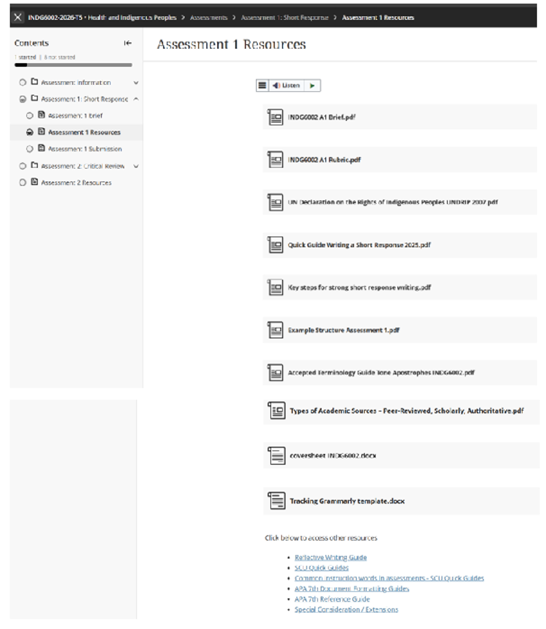
Assessment 1 Resources & Other Requirements

Slide 16
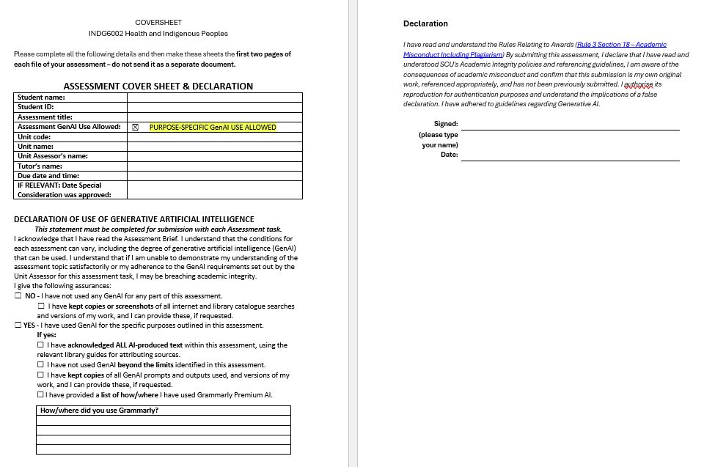
Assessment Coversheet & Declaration

Slide 17
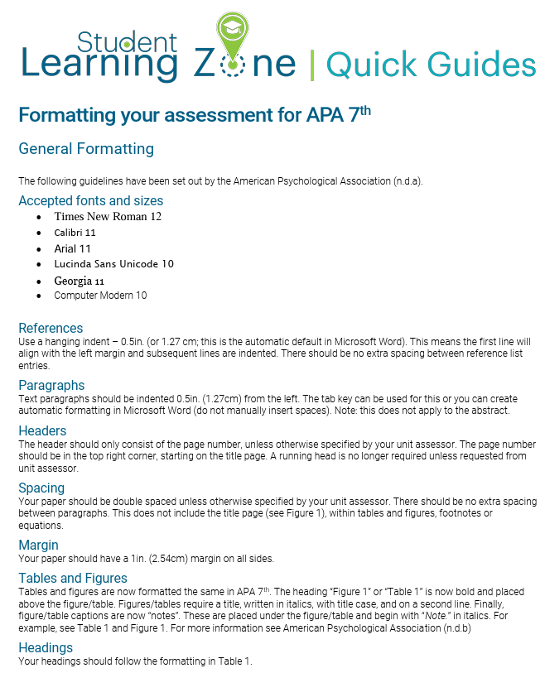
APA 7th Formatting your Document

Slide 18

GNIBI GenAI use
In Gnibi College units, the use of GenAI in assessments is generally restricted to protect the integrity and authenticity of the learning process. Indigenous Knowledges are grounded in lived experience, cultural practices, and relational ways of knowing. Engaging meaningfully with these knowledges requires personal reflection, respectful interpretation, and a commitment to culturally responsive learning, something that cannot be authentically achieved through AI-generated content.
Generative Artificial Intelligence (GenAI) tools, such as ChatGPT, may not be used for this Assessment Task.
You must demonstrate that you have developed the required knowledge and skills independently, without the assistance of GenAI tools. Unauthorised use of GenAI may be considered a breach of academic integrity under the Student Academic and Non-Academic Misconduct Rules (Section 3).’

Slide 19
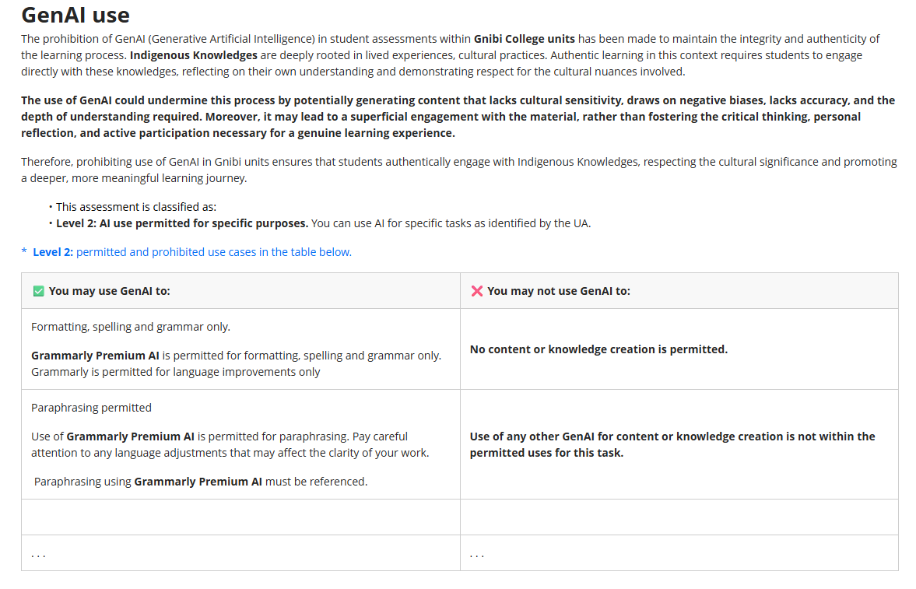
INDG6002 GenAI use

Slide 20
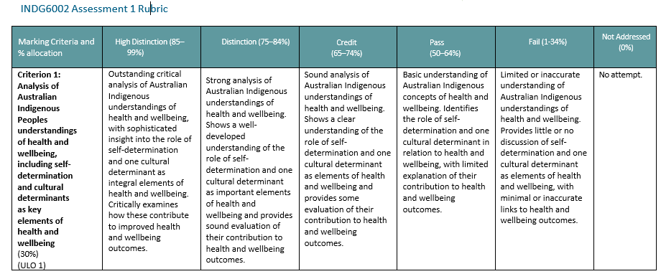
Assessment 1 Rubric – Criterion 1

Slide 21
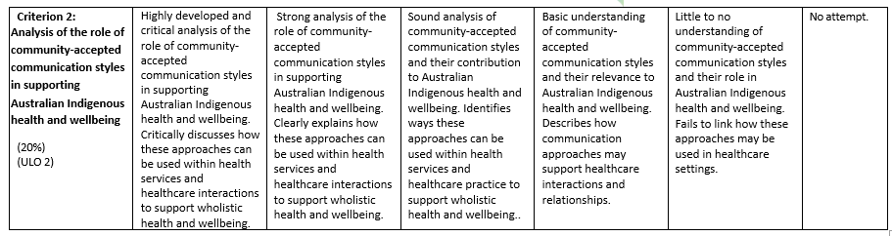
Assessment 1 Rubric – Criterion 2

Slide 22
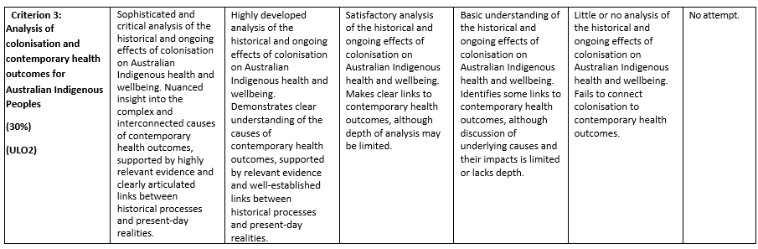
Assessment 1 Rubric – Criterion 3

Slide 23
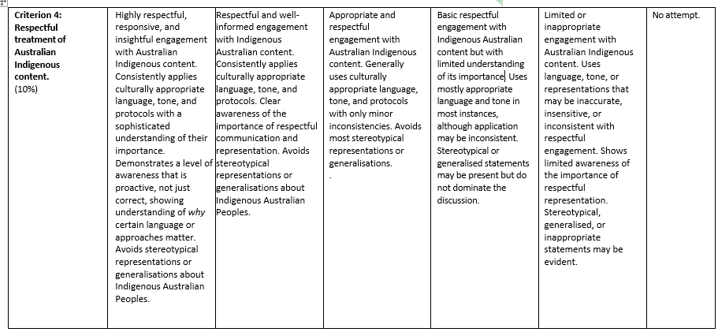
Assessment 1 Rubric – Criterion 4

Slide 24
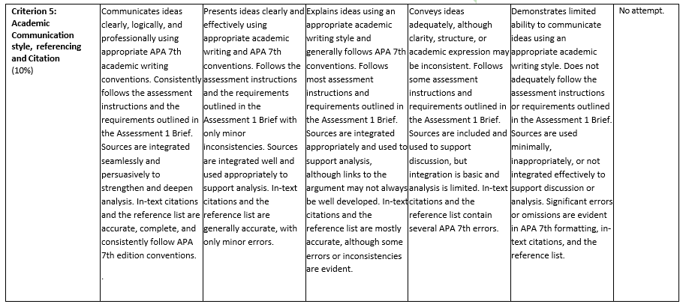
Assessment 1 Rubric – Criterion 5

Slide 25
Questions ….

Slide 26
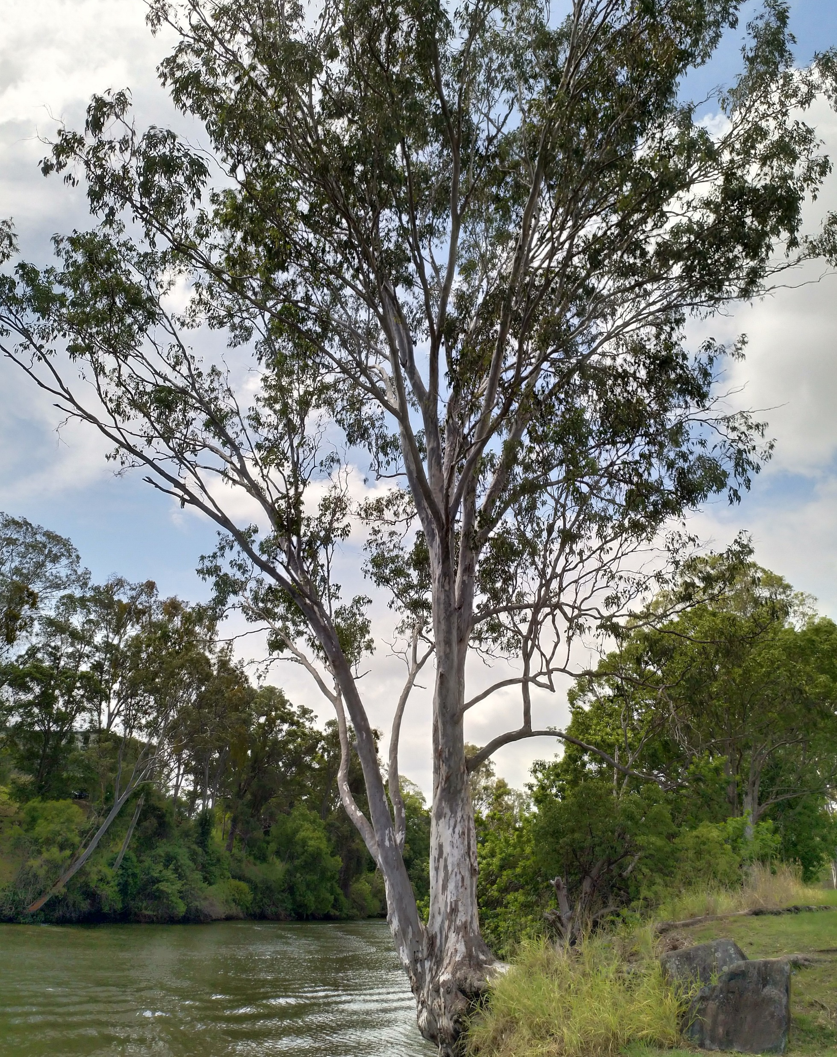
Until Next Time …

